Slide 1
Checkpoint
Public Speaking
Présenté par :
2022
2023
Safa Sellami

Slide 2


Social Networks strengthen human relationships
Social media is an internet-based form of communication. It allow users to have conversations, share information and create web content. There are many forms of social media, including blogs, micro-blogs, wikis, social networking sites, photo-sharing sites, instant messaging.

Slide 3
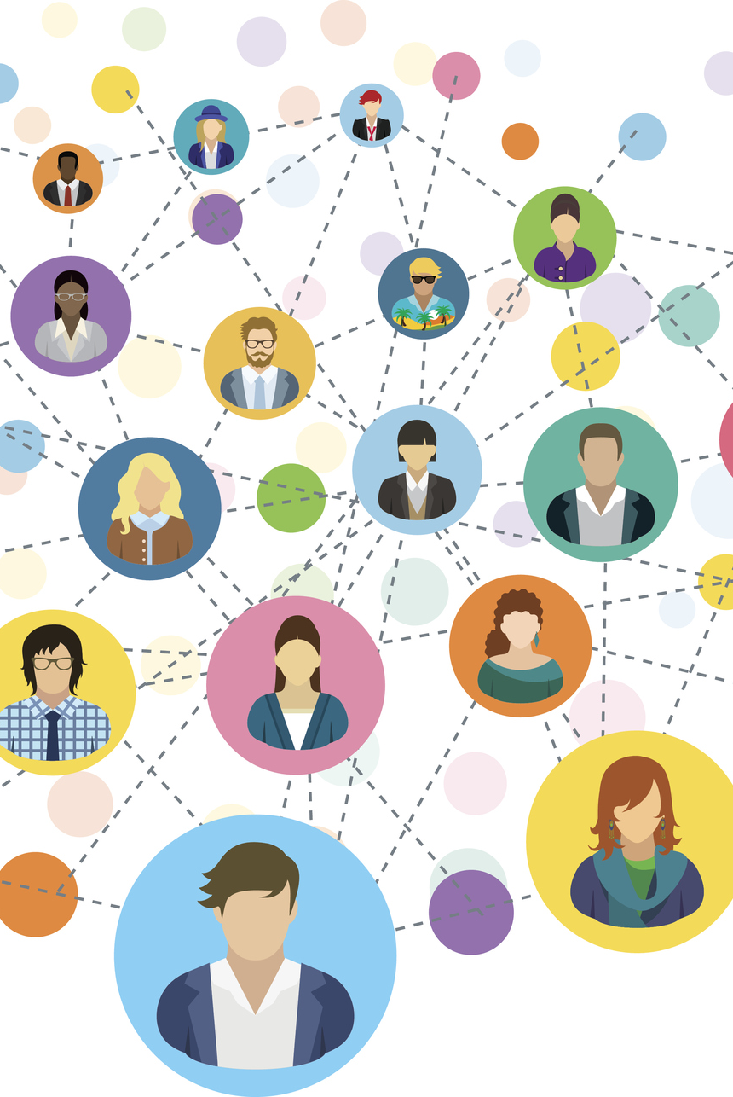

Factucal arguments (1/3)
1 . Boost Relationships : making it easy for people to stay in touch with family and friends.
It helped them to stay connected.
Access to news and information that social media facilitates and interact with others.
With social media we are able to connect with people who share similar interests.

Slide 4
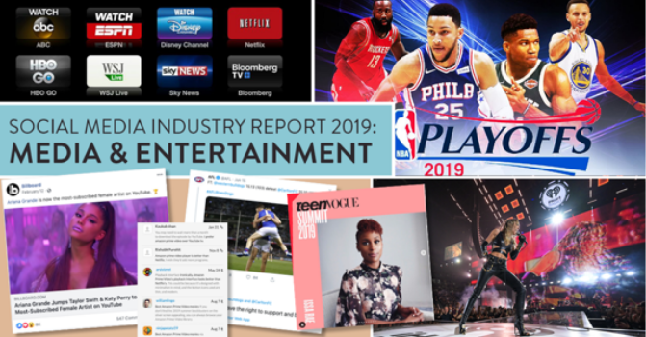
Factucal arguments (2/3)
2 . Entertainment
Some experts say over 75% of internet social media is entertainment.
While no one advocates spending hours after hours gaming, social media games can build social connections, improve a person’s self-efficacy, boost their cognitive flexibility and self-control. They can teach students how to deal with successes and failures in real life.

Slide 5
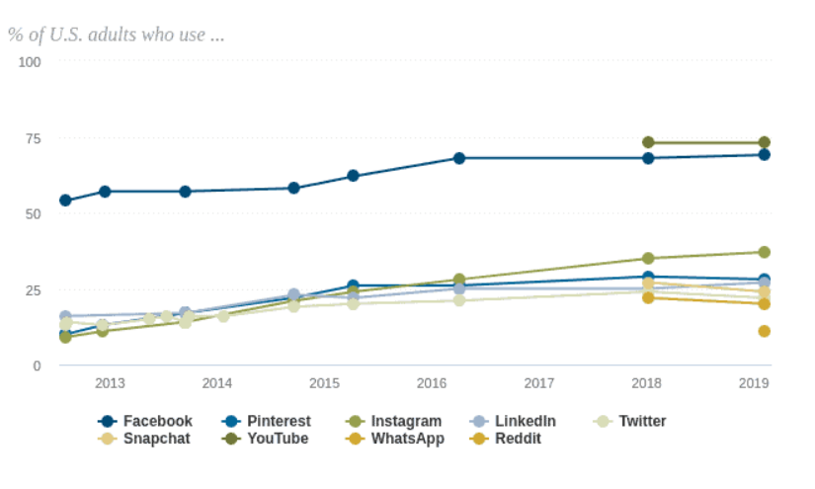

Factucal arguments (3/3)
LinkedIn is the most versatile platform to improve business relations. It helps to solidify connections and attract new people (from the same niche) as well.
3 . Improve professional relations

Slide 6
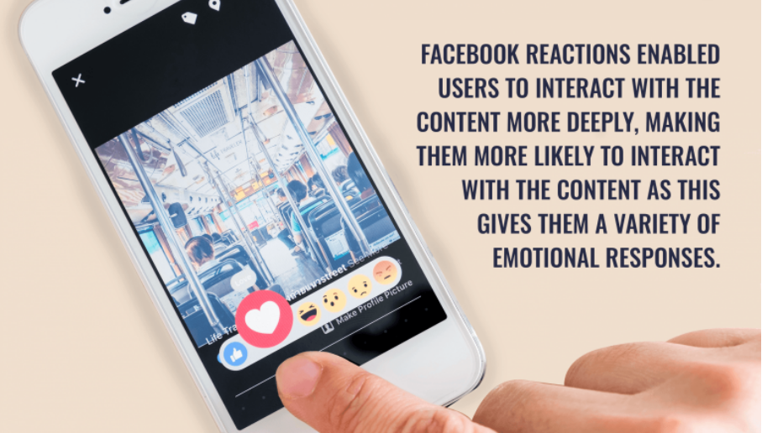
Emotional arguments (1/1)
1 . Love Booster : It creates a
space to boost relations in
distance.
It allows people to explore and become actively involved without the fear of rejection.
2 . Spark happiness in people : Feel less lonely or alone.
3 . Express émotions and connect with people who feel same way and .

Slide 7


Rational arguments (1/1)
Awareness : Be mindful and aware of your online environments and how they might be affecting you.
Marketing : Social media marketing uses social media and social networks to market a company's products and services.
Add creativity to our thinking : Social media can add creativity to our thinking as people can share their views and work with others.

Slide 8
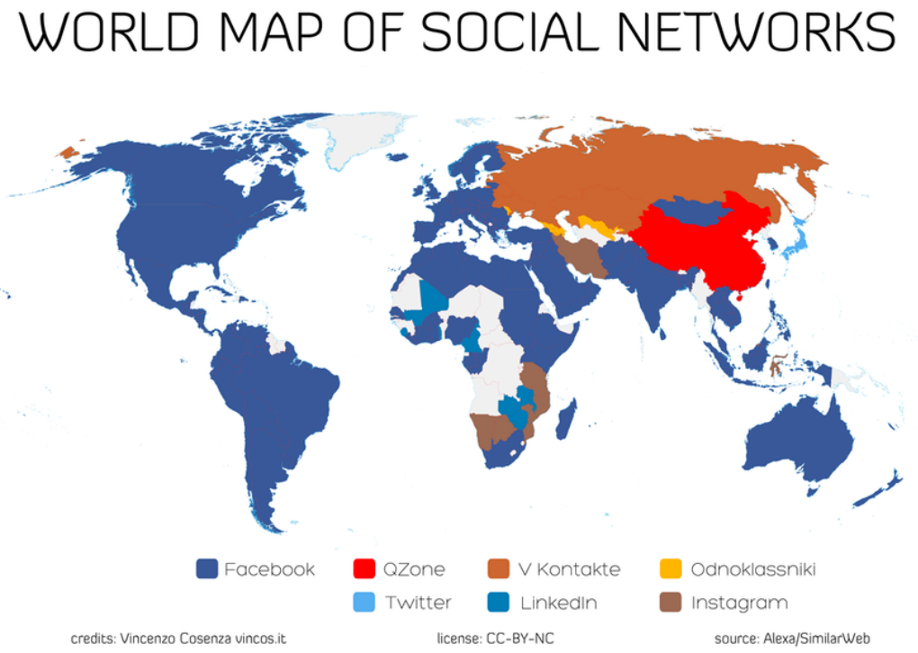

Slide 9
Merci pour votre attention

